Slide 1
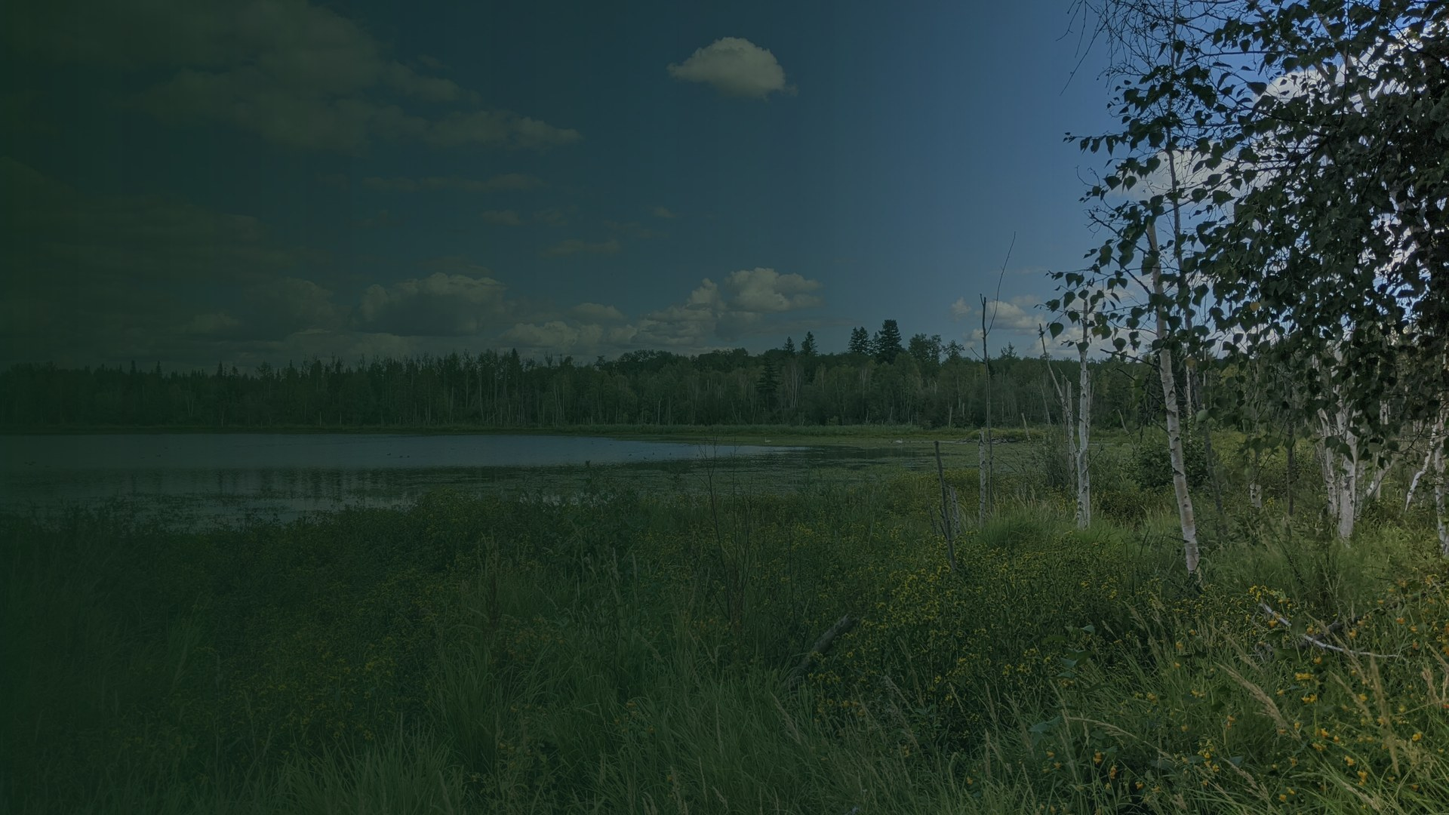
SIR-SAPAA · WEEKLY UPDATE
Sprint 3 is out.
Sprint 3 is released. Sprint 4 is under way.
Friday, October 30, 2026 · University of Alberta CMPUT 401
Aaron · Abhinav · Alissa · Chris · Jayden · Saumya · Zanab

Slide 2
TODAY
Three things.
1
What is new since last Friday
2
Sprint 4: what comes next
3
What we need from you
Then questions from the team, and a summary.
2

Slide 3
1
What is new
since last Friday
Oct 23 to Oct 30
3

Slide 4
SINCE LAST FRIDAY
Where your four projects stand.
Fixes
Sprint 3 is released. The export fix came after.
P1
Testing
1,895 unit tests passed, 0 failed (local run, Oct 26). Three Cypress specs fail.
2a
People
Profile history, activity totals and password reset are out.
2b
Maps
The map, GPX tracks and offline areas are out.
2c
Sprint 3 is released. Sprint 4 started on October 28.
4

Slide 5
ON OCTOBER 23
What you asked us on Oct 23.
GPX per site
Show the last five tracks for a site. Count, not time.
Track to a visit
Link one GPX track to a visit.
Terms and conditions
Tick boxes before the “let me in” button.
Proof of concept
Six steps, seven organisations, an advisory panel.
The two GPX items are a new story. The story has no points yet.
5

Slide 6
2
Sprint 4:
what comes next
Oct 28 to Nov 17
6

Slide 7
THIS SPRINT
What we will do, project by project.
Access
The access request form and the admin review.
2b
Testing
Close the two partial acceptance tests.
2a
Points
Activity points on the steward profile.
2b
Maps
Map legend, popup link and sites without a boundary.
2c
Reports
See all inspections in one combined view.
P1
7

Slide 8
SPRINT 4 · DUE NOVEMBER 17
What the plan has by November 17.
Oct 28
Planning · Sprint 3 demo and retrospective
Nov 15
Code freeze · All Sprint 4 work is merged
Nov 17
Release · Sprint 4 is out
Nov 29
Code freeze · All Sprint 5 work is merged
Dec 1
Final release · Field test and handover
Planned dates. The code freeze is two days before each release.
8

Slide 9
SPRINT 4 · DUE NOVEMBER 17
Sprint 4: the stories.
Points
Story 1.0.5. Earn points for inspection activity. Five points.
Open
2b
Sign-up
Story 5.0.5. Request access during sign-up. Eight points.
Open
2b
OAuth
Story 5.0.6. Access with Google or Microsoft. Five points.
Open
2b
Review
Stories 5.0.7 to 5.0.9. Admin review, terms and status. Sixteen points.
Open
2b
Reports
Story 7.0.3. See all inspections in one view. Five points.
Open
P1
Seven stories. Thirty-nine points. Twenty points are free.
9

Slide 10
PROJECT 2C · MAPS
The map, in your four layers.
1
Base map
Alberta on load. Online and offline.
Working
2
Boundaries
A site links to its boundary when the names match.
Working
3
History
GPX tracks draw on the map.
Working
4
Data views
No data layer is built yet.
Later
The link uses the exact site name. Unmatched sites need an admin.
10

Slide 11
THE CALENDAR WE WORK TO
Where we are on the calendar.
Sprint 1
Sprint 2
Sprint 3
Sprint 4
Sprint 5
Sep 29
Oct 13
Oct 26
Nov 17
Dec 1
Documentation
and discovery
Version 1.1,
released
The map and
history
Access requests
and points
Field test and
handover
Sprint 3 released Oct 26. Sprint 4 ends November 17.
11

Slide 12
3
What we
need from you
Decisions for Sprint 4
12

Slide 13
FOR SPRINT 4
Six decisions we need from you.
1
Password reset: Resend (100/day) or Brevo (300/day)?
2
Supabase production credentials: who shares them?
3
Terms and conditions: do you approve the draft?
4
December field test: which weekend, and who tests?
5
Priority score: do you confirm our formula?
6
New UI (v2): replace the current UI, or keep both?
The five decisions from October 16 also have no answer.
13

Slide 14
SPRINT 4 · NOVEMBER 17
What Sprint 4 holds.
Access requests
Five stories. Twenty-nine points.
Inspection history
Activity points on the profile. Five points.
Combined view
One inspection view for all sites. Five points.
Proof of concept
Proposed. No estimate. It needs your two requirements.
Sprint 4 is 39 points against a re-estimate of 59. Twenty points are free.
14

Slide 15
SUMMARY
Today in one slide.
This week
Next week
Coming up
Sprint 3 released
Export fix after release
Sprint 4 started
Local test run recorded
Access request stories
Fix three Cypress specs
Close two acceptance tests
Nov 17: Sprint 4
Dec 1: final release
December: field test
15

Slide 16
Round table.
Frank picks the order. Bring your test results.
16

Slide 17
BACKUP · SPRINT 3
Sprint 3: what shipped.
Map of sites and past visits
Site popup from the map
2c
2c
GPX track upload and map lines
Offline map areas
2c
+
To-visit priority score
Profile history and activity totals
P1
2b
Export all files
Password reset and past-report edit
P1
P1
Fourteen stories and 68 points. US 3.0.4 was removed by the client.
17

Slide 18
BACKUP · SPRINT 3
Sprint 3: story status.
STORY | PROJECT | STATUS
1.0.3 Profile inspection history | 2b | Shipped
1.0.4 Profile activity totals | 2b | Shipped
1.0.6 Skills and focus areas | 2b | Shipped
2.0.1 Map sites and past visits | 2c | Shipped
2.0.8 Site details from the map | 2c | Shipped
2.0.9 GPX upload | 2c | Shipped
2.0.12 To-visit priority | P1 | Shipped
2.0.13 Old-score reminder | P1 | Shipped
2.0.14 Boundary colors | 2c | Shipped
3.0.3 Export all digital files | P1 | Shipped
4.0.2 Offline and online maps | Team | Shipped
4.0.4 Edit previous reports | P1 | Shipped
5.0.2 Password reset | P1 | Shipped
6.0.1 Site boundaries | 2c | Shipped
3.0.4 Stewards without an account | — | Removed by client
18

Slide 19
BACKUP · OPEN ITEMS
What is not done.
Production migrations
A human must apply the SQL. The map and export do not work in production until then.
Three test specs
map_site_popup may be a date bug. profile AT5 and map_filter are out of date.
Two acceptance tests
2.0.1 AT1 and 4.0.4 AT4 are partial.
Priority formula
We need Frank to confirm the formula (issue #333).
Sprint 4 issues #329 to #335 are open. We report at the next meeting.
19

Slide 20
BACKUP · THE NEW UI
The v2 branch: what we found.
What it is
A mobile-first second UI under /v2, with demo data. No PR or issue exists for it.
Tests
It deletes 3 Cypress specs and the Cypress baseUrl.
Accessibility
It removes the keyboard focus ring in globals.css.
Duplication
It duplicates the v1 flows. Admin screens check the role on the client; the server re-checks.
We need your direction: replace the current UI later, or keep v2 as a side prototype.
20

